Slide 1




Joint Machine Learned Potentials (MLPs) Journal Club
8/6/25
Our predecessor, Dr. Zhang
Will
Mike

Slide 2

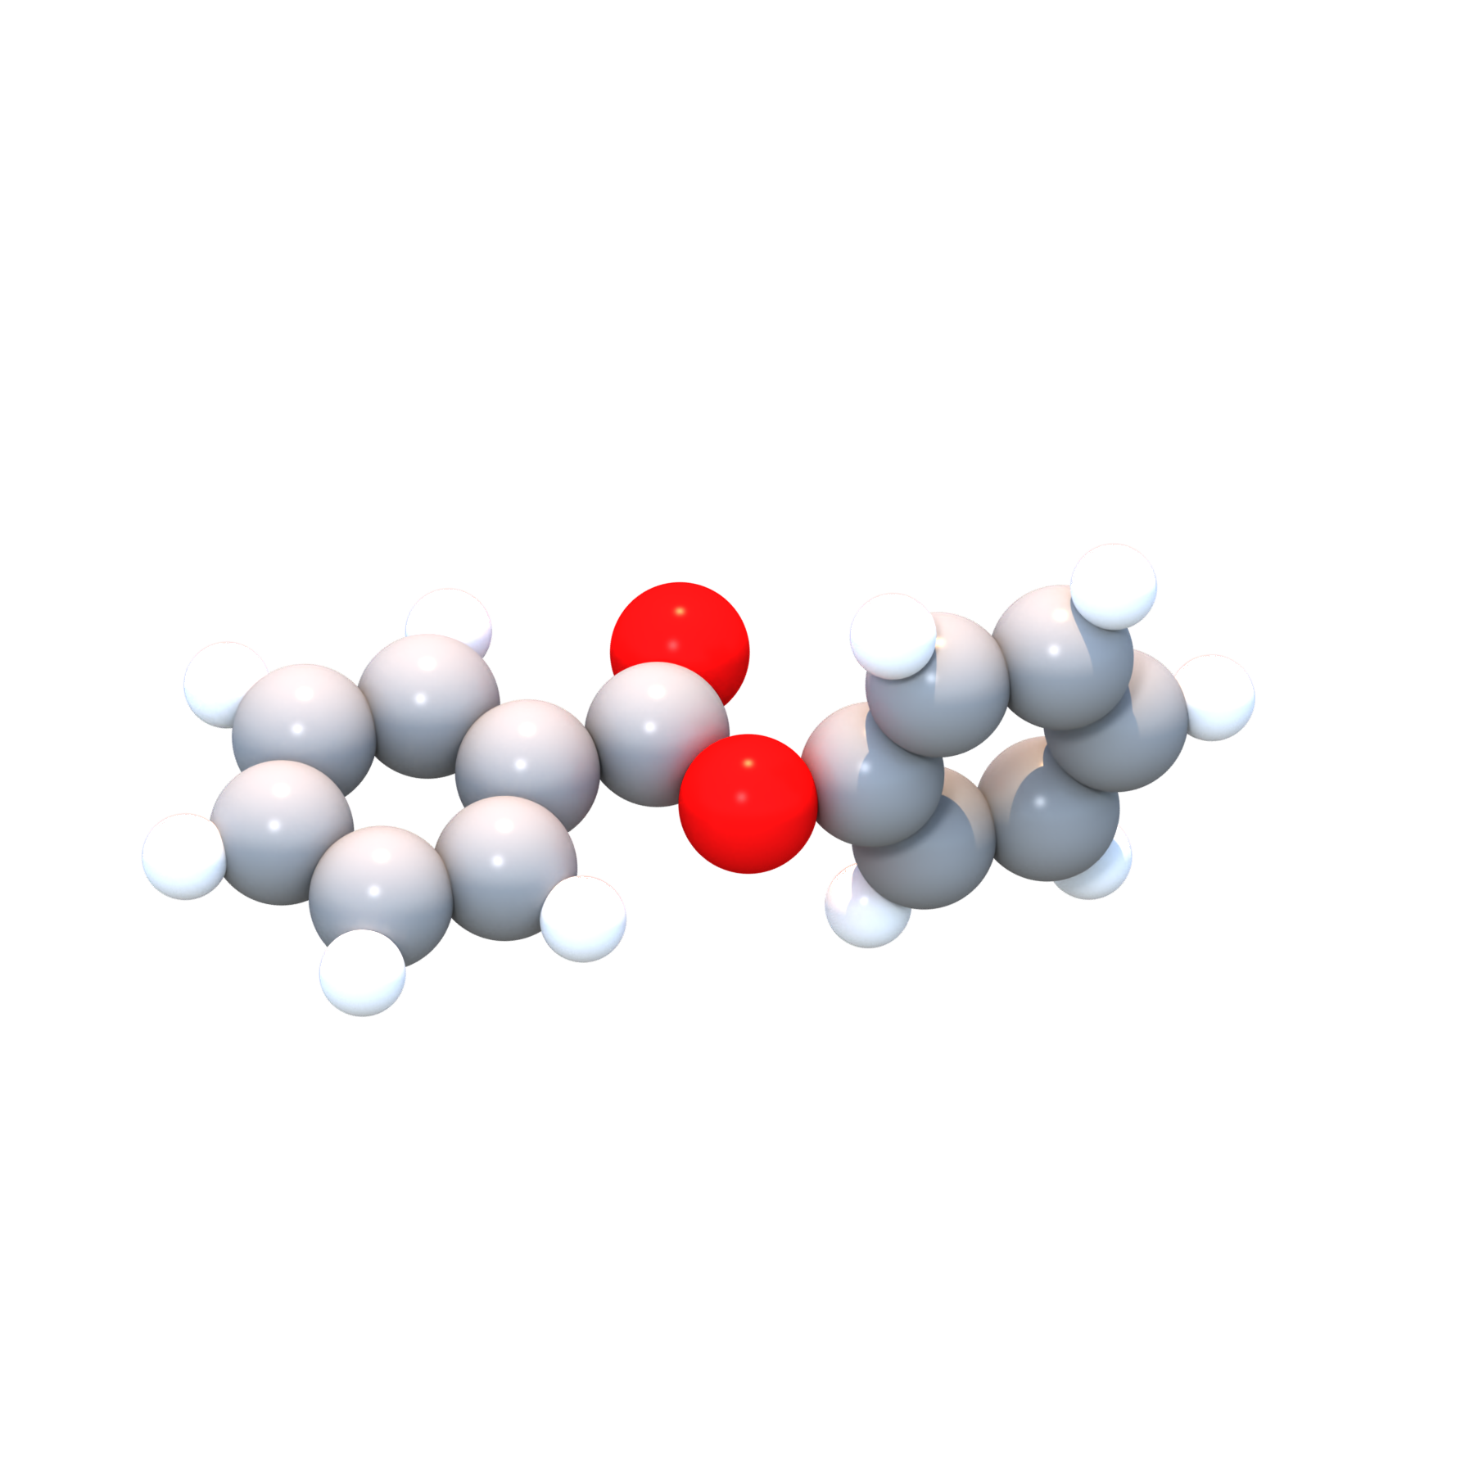
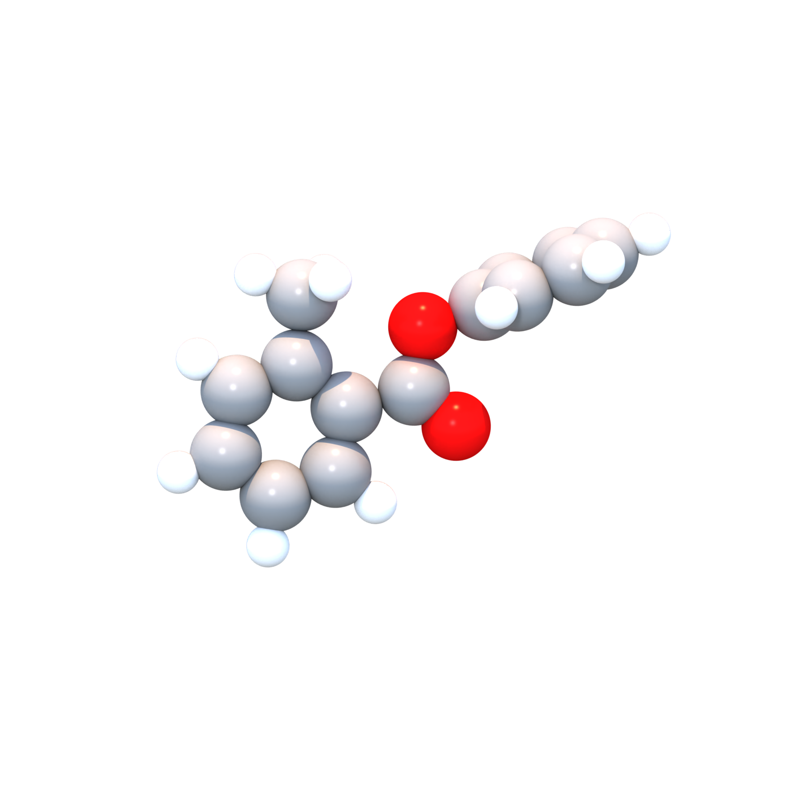
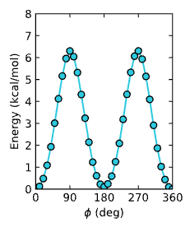
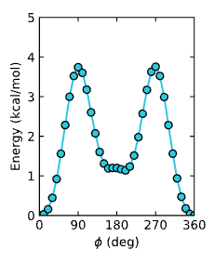
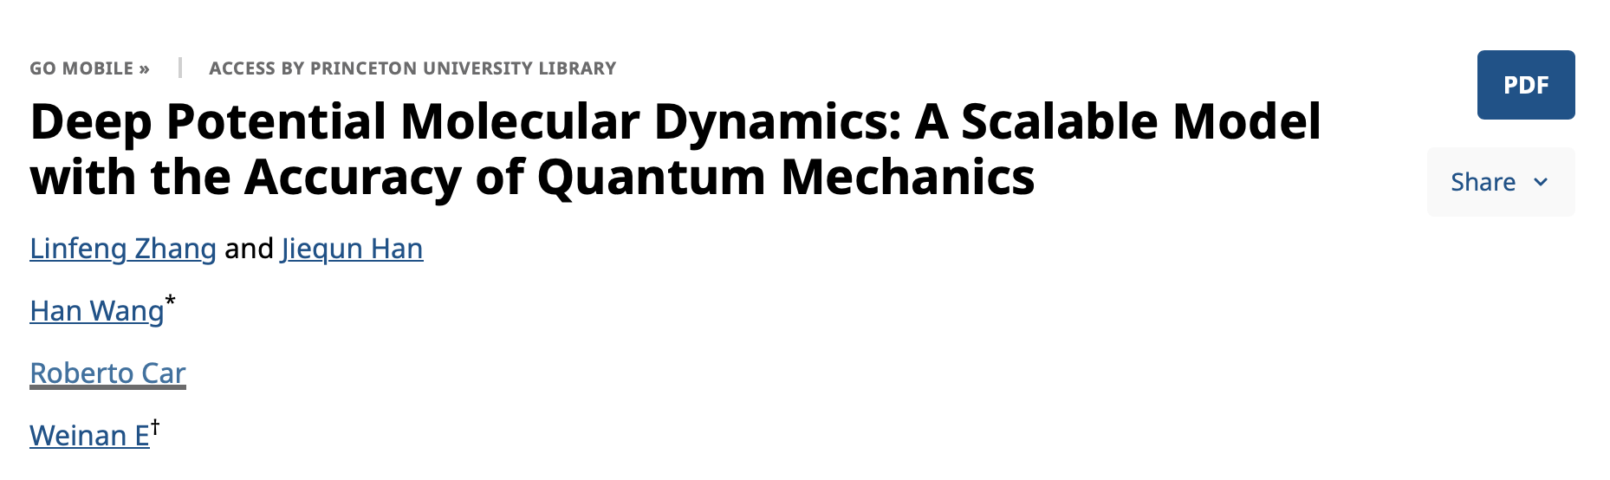
Personal motivation to start this journal club
MLPs are becoming increasingly important to molecular modelers
The rise of foundation models
We have a high concentration of experts in MLPs to learn from!
Goal: Brief, informal discussions focused on learning about the foundation of this field
P-core
M-core
UMA-s mode scan captures methylation-dependent energy-barrier change in liquid-crystal core.

Slide 3
Schedule
Introduction to MLPs - Jacob
DeepMD/DeepCG - Ryan
Keystone papers to survey the field
After this, we will wait until next semester and then vote on a new topic for the ‘next’ journal club
Weeks 1-3
Geometric Machine Learning - Quinn
Foundation Models - Wes
Modern papers in applications, showcasing SOTA
Applications Paper – Yura
Weeks 4-6
Protein Dynamics MLP Paper - Moritz

Slide 4
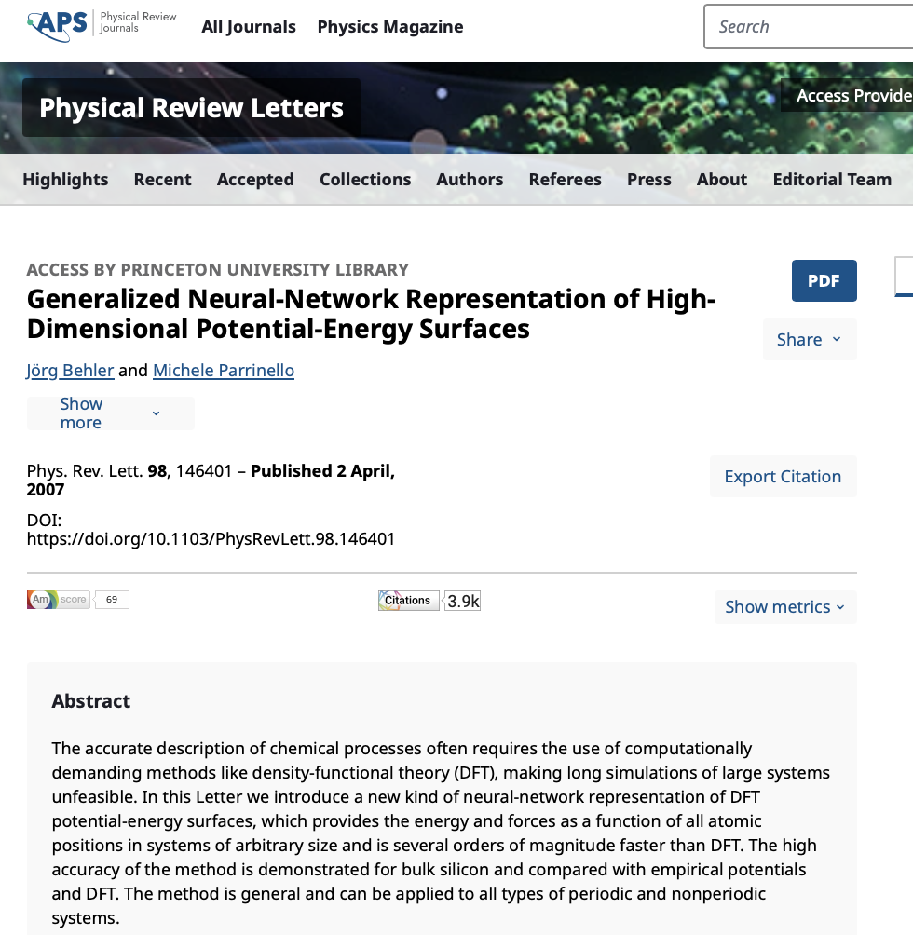
Let’s get started!

Slide 5
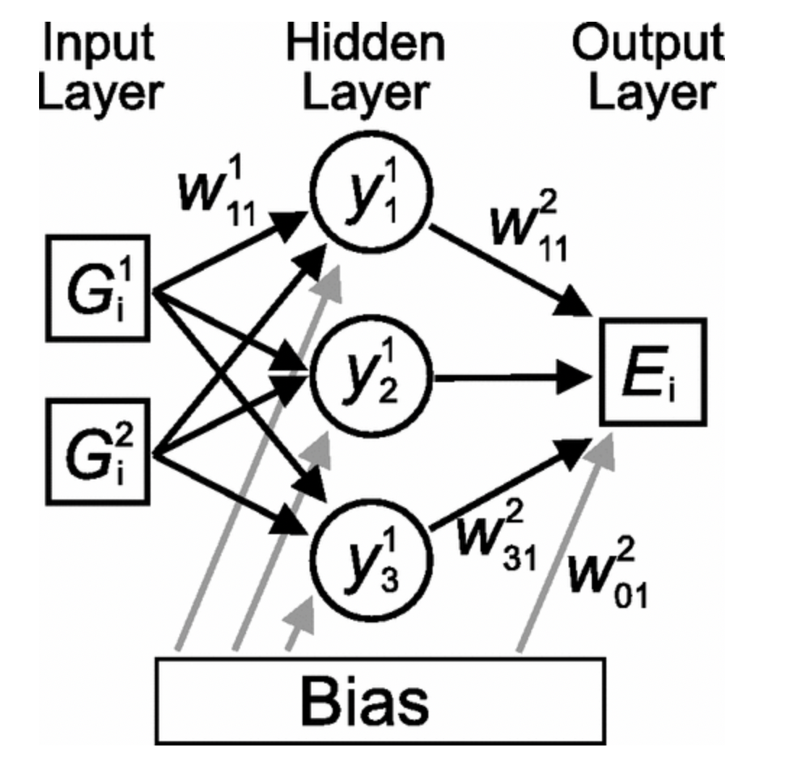
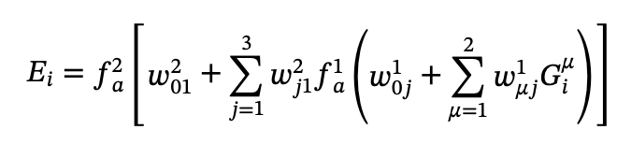
Historically used standard NN to fit potential energy surfaces (pre 2007)
bias
weights
Activation function
Generalized coordinates for molecule 1,2,..k as input
Benefits of this architecture
Limitations of this architecture
Captures multibody interactions with DFT accuracy
Less computationally expensive than Car-Parinello MD/DFT
This architecture must learn symmetry (and often doesn’t)
Limited degrees of freedom
S. Lorenz, A. Groß, and M. Scheffler, Chem. Phys. Lett. 395, 210 (2004).
T. B. Blank et al., J. Chem. Phys. 103, 4129 (1995).

Slide 6
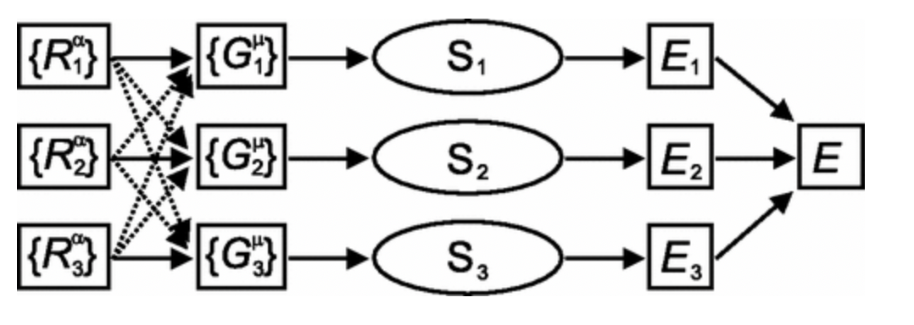
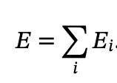
Parinello’s 2007 MLP architecture
Intermediate coordinates which encode symmetry
Decomposition of total energy into individual atom’s contributions. E_{i} is learned through training and additivity is enforced
Limitations of old architecture
How this architecture addresses those limits
This architecture must learn symmetry (and often doesn’t)
Limited degrees of freedom
Transformation to symmetry functions
Individual sub-networks for each atom
Identical sub-networks

Slide 7
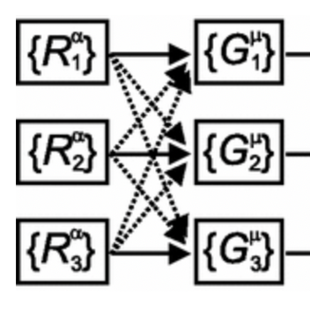
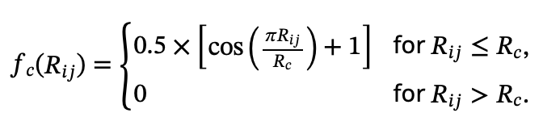
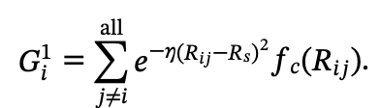
Symmetry functions as features
Symmetry functions employ a switching function to define relevant chemical environment. (Both derivative and function must be 0 at R_{c})
Gaussian symmetry functions encode radial information
Angular symmetry functions encode orientational information

Slide 8
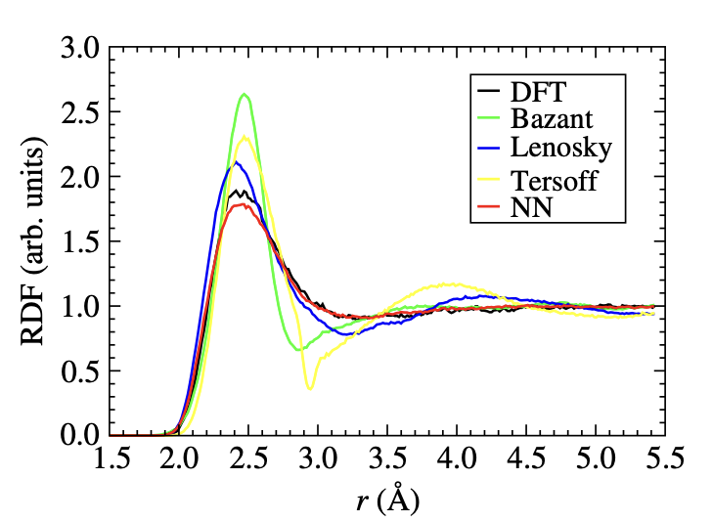
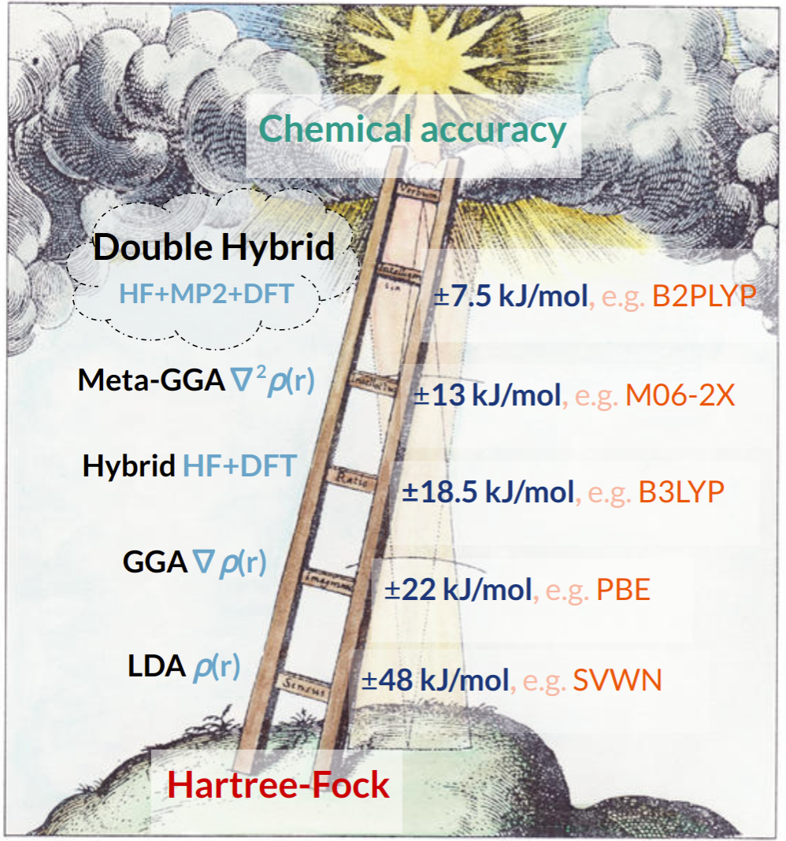
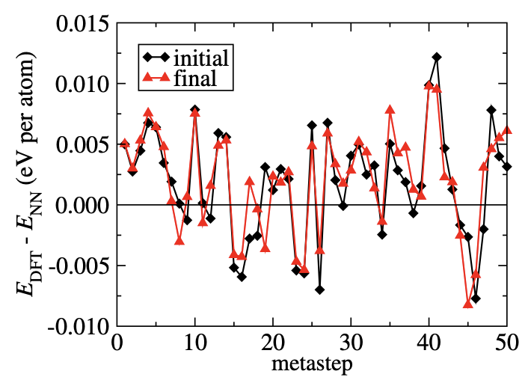

Performance on bulk silicon
Data acquisition and training
This is what Sharon taught us in our quantum class
1. Seed: start from crystal structures and MD snapshots across pressures/temperatures.
2. Training loop: run metadynamics with a initial NN -> DFT-relabel configs -> augment data -> retrain; repeat. (Used LDA functional)
3.Stop: when errors stabilize (ended up with ~9k DFT configs).
Summary: This paper introduced sub-networks, symmetry functions, and switching functions which are the foundation upon which modern models are built
Our groups are here (mostly)
MD (Hell)

Slide 9
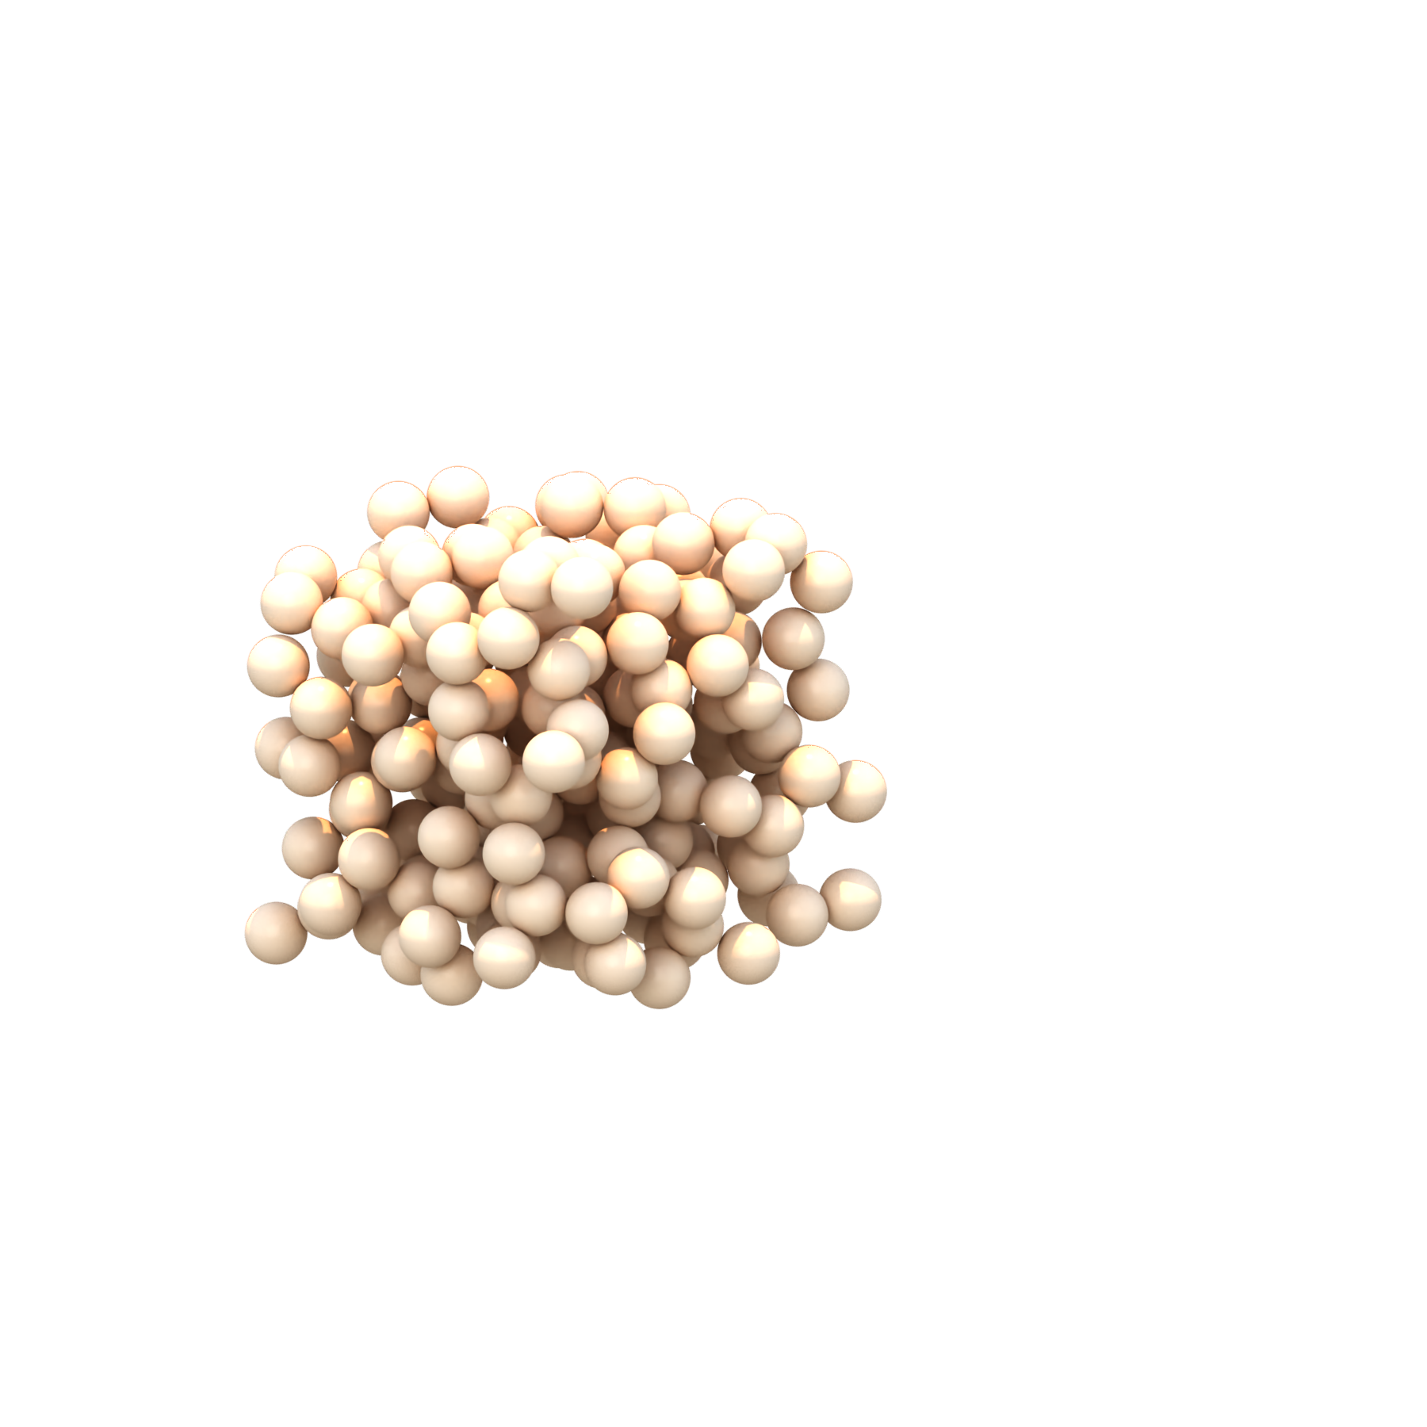
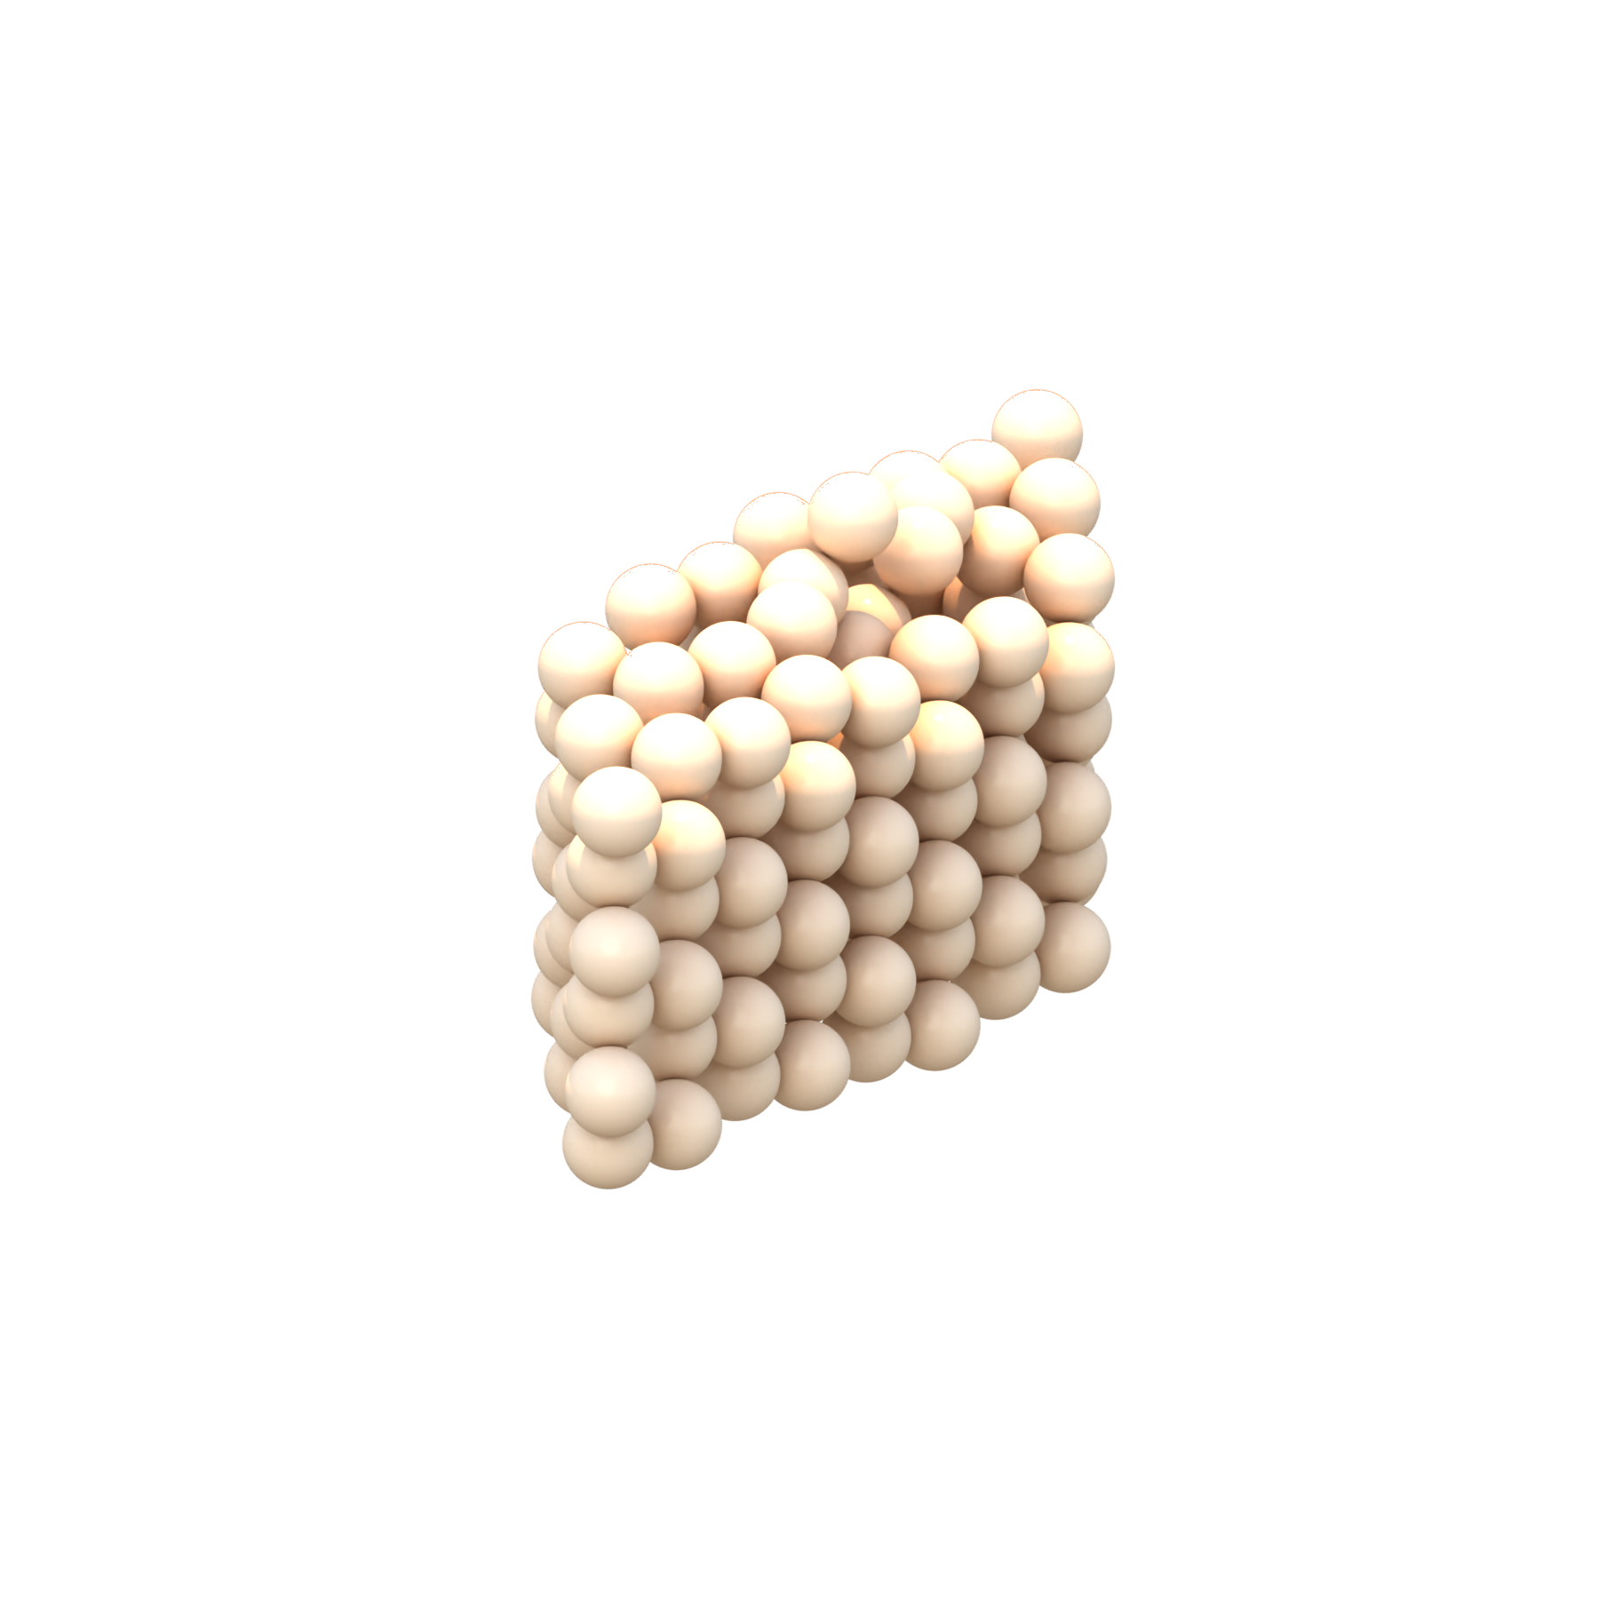
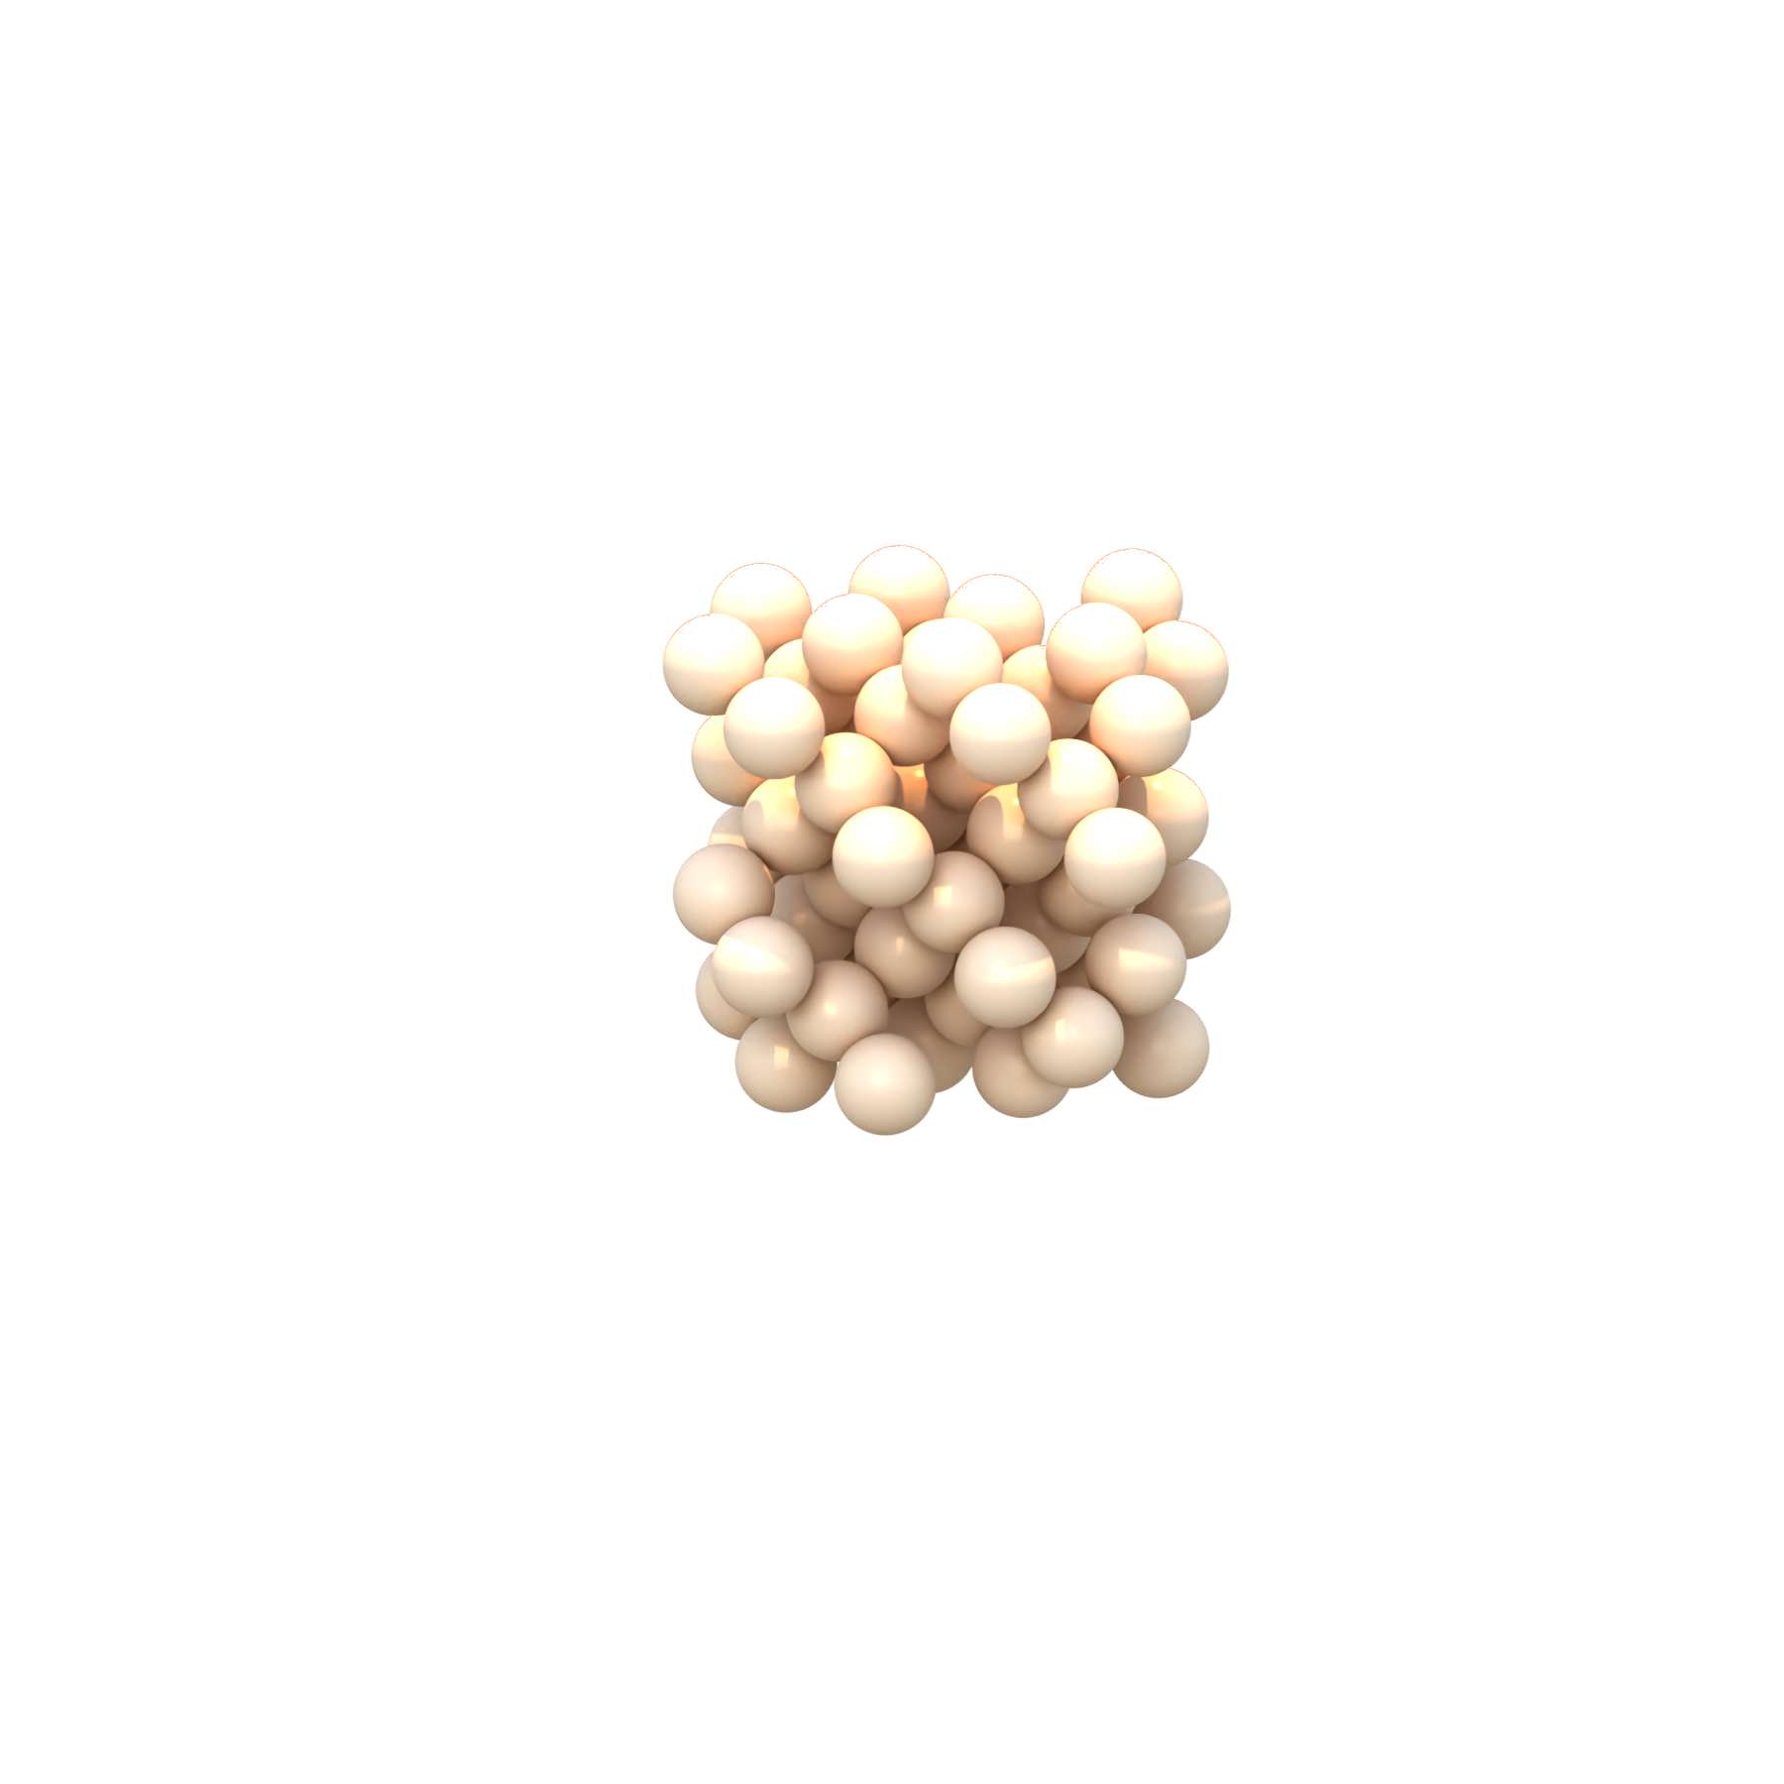
Exercise – let’s investigate why symmetry functions are important
Example conformations from Cambridge dataset (rendered with OVITO)
We will train a simple model with and without symmetry functions and compare the RMSE
Data from: Csanyi, G. (2021). Research data: Machine learning a general-purpose interatomic potential for silicon. Apollo - University of Cambridge Repository. https://doi.org/10.17863/CAM.65004

Slide 10
Discussion
Long range interactions?
Choice of symmetry functions?

